Slide 1
Case Study
REST Endpoints Documentation

Slide 2
Project Overview
This utility makes use of following technologies to list all the available endpoints in the application on UI beautifully…
Reflection (java.lang.reflect) – introspect classes
Java IO (java.io) – to read class files
Java Annotations (java.lang.annotation) – added new annotations
REST API (javax.ws.rs)
Spring Framework (org.springframework) – few utility classes
Angular.js 1.4.4
angular-resource.js 1.2.11
angular-md/showdown.js (for Markdown support)

Slide 3
Problem Definition
We have developed a huge number of REST endpoints but are not documented properly
The existing separate documentation is not updated regularly and it is not in sync with the latest implementation
Prepare an utility to display all available REST endpoints on the UI
Keep the documentation of end points close to the implementation
Should be compatible with Java 1.5+
It must be a subset of Swagger
We cannot give it more than a week for development

Slide 4
Solution
While exploring the solution, initially tried to configure Swagger – a popular tool for REST API documentation. But
Found that it does not fit our requirement
Swagger requires Java 6+
It has lot of other dependencies which additional approval from Eclipse Administrators
So it was decided develop our own utility

Slide 5
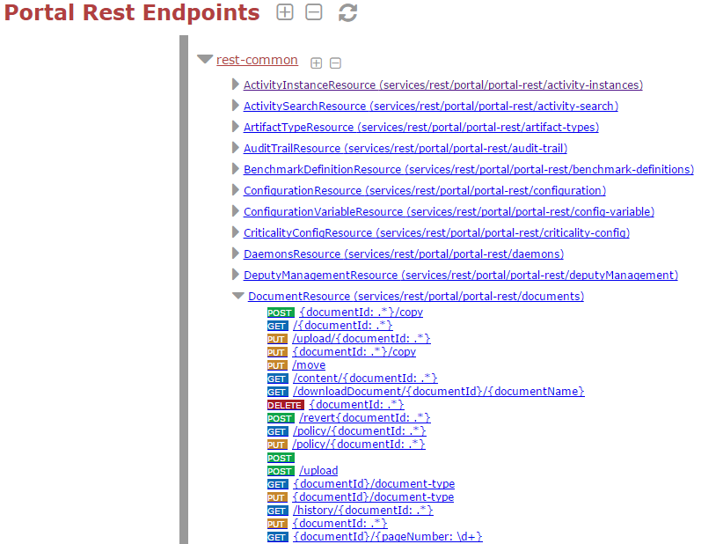
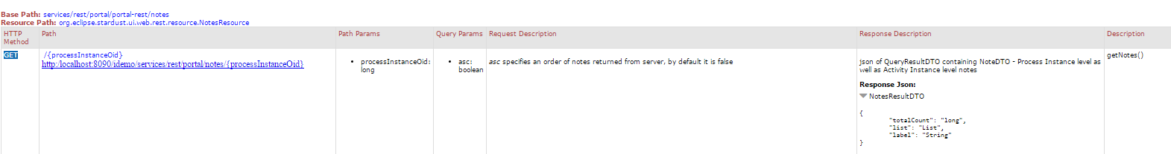
Solution

Slide 6
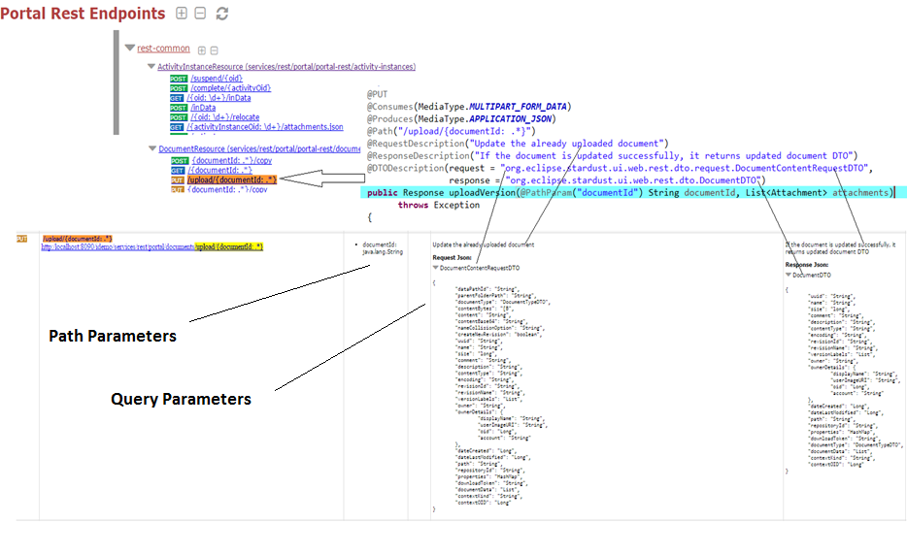
Solution

Slide 7
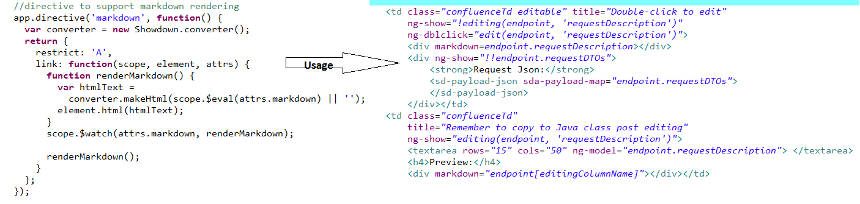
Solution (Directives used)

Slide 8
My contribution
I was an exclusive developer of this solution.
I have designed and implemented it end to end.
As our product is open source, the relevant source code is available on Eclipse/Stardust GIT repository

